Slide 1
Software Development 2
Exploring Polymorphism
F27SB

Slide 2
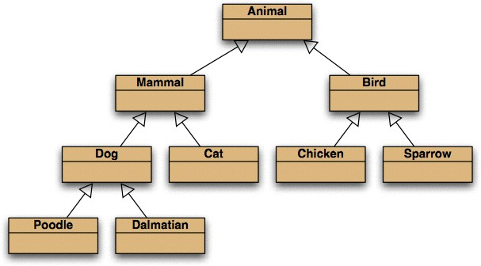
Inheritance hierarchies
Socrative room: F27SB
Chicken is a subtype of Animal:
Animal a = new Chicken(); ✔

Slide 3
Inheritance and Polymorphism
RECAP

Slide 4


Last lecture
Polymorphism (lit.: The occurrence of something in different forms)
Polymorphic variables
Animal a = new Chicken();
Polymorphic collections
List<Animal> farm =
new ArayList<Animal>(); farm.add(chicken);

Slide 5
TODAY’S LECTURE

Slide 6
Main concepts to be covered
method polymorphism
static and dynamic type
overriding
dynamic method lookup
protected access

Slide 7
More detail on last week’s solution
THE PROBLEM WITH THE DISPLAY FUNCTION

Slide 8

Conflicting output
Leonardo da Vinci
Had a great idea this morning.
But now I forgot what it was. Something to do with flying ... 40 seconds ago - 2 people like this.
No comments.
Alexander Graham Bell [experiment.jpg]
I think I might call this thing 'telephone'. 12 minutes ago - 4 people like this.
No comments.
What we want

Slide 9
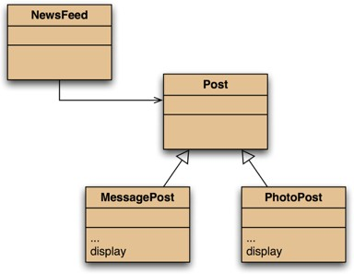

Attempting to solve the problem
Place display where it has access to the information it needs.
Each subclass has its own version.
But Post’s fields are private.
Compiler Error: Fields of Post are not visible in subclasses

Slide 10
Use private where possible!
VISIBILITY MODIFIERS

Slide 11
Protected access
Private access in the superclass may be too restrictive for a subclass.
The closer inheritance relationship is supported by protected access.
Protected access is more restricted than public access.
We still recommend keeping fields private.
– Define protected accessors and mutators.

Slide 12
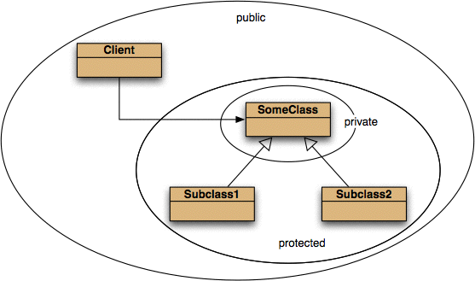
Access levels

Slide 13
Access Modifiers
Modifier | Class | Package | Subclass | World
public | Y | Y | Y | Y
protected | Y | Y | Y | N
(none) | Y | Y | N | N
private | Y | N | N | N
Notes:
Default visibility. In Java, there are four visibility scope (default, private, protected and public) but only three visibility modifiers (private, protected and public). If you don't defineany visibility it gets default visibility scope. It is only visible and accessible within the package.

Slide 14
Good practice for Access Levels
Use the most restrictive access level that makes sense for a particular member.
Use private unless you have a good reason not to.
Avoid public fields except for constants.
Public fields tend to limit your flexibility in changing your code.

Slide 15
Some basics first
ACCESS LEVELS AND TYPES

Slide 16
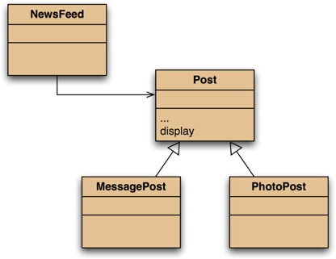
The inheritance hierarchy

Slide 17

Conflicting output
Leonardo da Vinci
Had a great idea this morning.
But now I forgot what it was. Something to do with flying ... 40 seconds ago - 2 people like this.
No comments.
Alexander Graham Bell [experiment.jpg]
I think I might call this thing 'telephone'. 12 minutes ago - 4 people like this.
No comments.
What we want
Leonardo da Vinci
40 seconds ago - 2 people like this. No comments.
What we have
Alexander Graham Bell
12 minutes ago - 4 people like this. No comments.

Slide 18
The problem
The display method in Post only prints the common fields.
Inheritance is a one-way street:
A subclass inherits the superclass fields.
The superclass knows nothing about its subclass’s fields.

Slide 19
Static type and dynamic type
A more complex type hierarchy requires further concepts to describe it.
Some new terminology:
static type
dynamic type
method dispatch/lookup

Slide 20






Static and dynamic type
Socrative room: F27SB
What is the type of c1?
Car c1 = new Car();
Car
What is the type of v1?
Vehicle v1 = new Car();
It’s complicated

Slide 21
In a Nutshell
“TYPE of v1” can mean two different things:
“the type of VARIABLE of v1 ”
“the type of the OBJECT stored in v1”
Vehicle v1 = new Car();
Type of variable v1 == Vehicle
Type of object v1 == Car
Variable polymorphism
Type of variable = STATIC type
Type of Object = DYNAMIC type (assigned at runtime).

Slide 22



Static and dynamic type
The declared type of a variable is its
static type.
The type of the object a variable refers to is its dynamic type.
The compiler’s job is to check for static- type violations.
for(Post post : posts) { post.display();
}
How do we make this compile
and also print the required information?

Slide 23
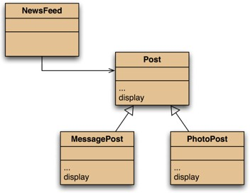




Overriding: the solution
display method in both super- and subclasses.
Satisfies both static and dynamic type checking.

Slide 24
METHOD OVERRIDING

Slide 25
Method Overriding
Superclass and subclass define methods with the same signature.
Each has access to the fields of its class.
Superclass satisfies static type check.
Subclass method is called at runtime – it overrides the superclass version.
What becomes of the superclass version?

Slide 26
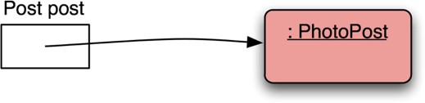
Distinct static and dynamic types

Slide 27
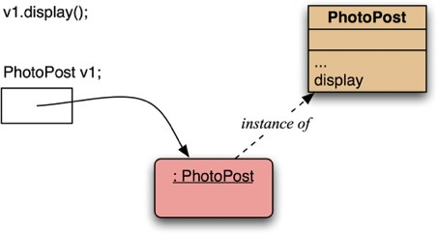

Method lookup
No inheritance or polymorphism. The obvious method is selected.

Slide 28
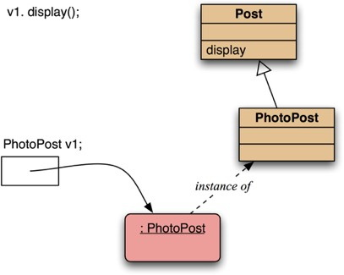

Method lookup
Inheritance but no overriding. The inheritance hierarchy is ascended, searching for a match.

Slide 29
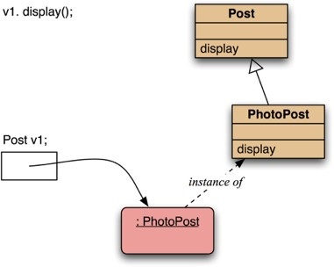



Method lookup
Polymorphism and overriding. The ‘first’ version found is used.

Slide 30
Method lookup summary
The variable is accessed.
The object stored in the variable is found.
The class of the object is found.
The class is searched for a method match.
If no match is found, the superclass is searched.
This is repeated until a match is found, or the class hierarchy is exhausted.
Overriding methods take precedence.

Slide 31
Super call in methods
Overridden methods are hidden ...
... but we often still want to be able to call them.
An overridden method can be called from the method that overrides it.
super.method(...)
Compare with the use of super in constructors.

Slide 32

Calling an overridden method
public void display()
{
System.out.println(" [" + filename + "]"); System.out.println(" " + caption); super.display();
}
(display method in PhotoPost. )

Slide 33
Method polymorphism
We have been discussing polymorphic method dispatch.
A polymorphic variable can store objects of varying types.
Method calls are polymorphic.
The actual method called depends on the dynamic object type. Determined at runtime.
Casting doesn’t make a difference. Only relevant at compile time.

Slide 34
MORE EXAMPLES

Slide 35

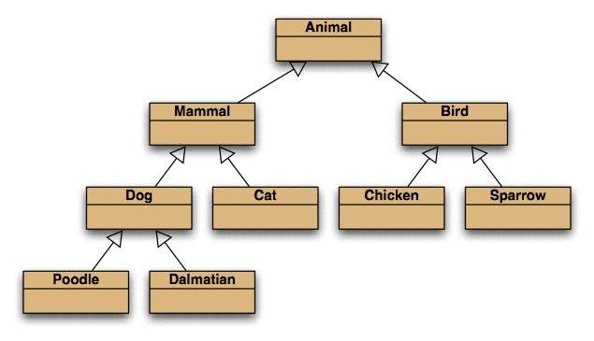
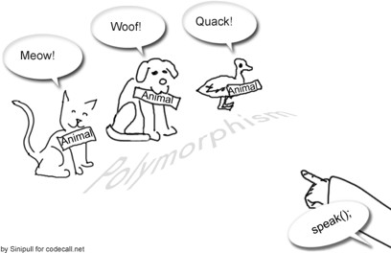


Quiz: Where is the speak method?
Socrative room: F27SB
Duck
for(Animal animal : animals){ animal.speak();
}
Might be more than one class!

Slide 36

Example for Polymorphic Methods
public class Animal
{
public void speak() { System.out.println(”Not much to say…");
}
}
public class Duck extends Animal
{
public void speak() { System.out.println(”Quack!");
}
}

Slide 37

Example for Polymorphic Methods
List<Animal> animals =
new ArrayList<Animals>();
Animal duck = new Duck(); Animal cat = new Cat();
animals.add(duck); animals.add(cat);
…
for(Animal animal : animals){ animal.speak();
}

Slide 38


Subtyping and method overriding
public class Mammal
{
public void act() { System.out.println("Mammals act");
}
}
public class Cat extends Mammal
{
public void act() { System.out.println("Cats act (up)");
}
public void purr() { System.out.println(“Purr!");
}
}

Slide 39

Subtyping and method overriding
public class TestAnimals
{
public static void main(String[] args){
//It's still a cat, but labeled as Mammal Mammal m = new Cat();
//methods overidden by Cat will be executed m.act();
//but you can only access the methods of Mammal!
//the methods of cat are invisible! m.purr();
//you can re-discover the cat by downcasting Cat c = (Cat) m;
//now the cat can purr again :) c.purr();
}

Slide 40

The instanceof operator
Used to determine the dynamic type.
Recovers ‘lost’ type information.
Usually precedes assignment with a cast to the dynamic type:
if(animal instanceof Cat) { Cat cat = (Cat) animal; cat.purr();
}

Slide 41
Functions common to all classes
THE OBJECT CLASS’S METHODS

Slide 42
The Object class’s methods
Methods in Object are inherited by all classes.
Any of these may be overridden.
The toString method is commonly overridden:
public String toString()
Returns a string representation of the object.

Slide 43

Example
Post pp = new PhotoPost(); pp.toString();
>> PhotoPost@6acdd1

Slide 44

Overriding toString in Post
public String toString()
{
String text = username + "\n" +
timeString(timestamp); if(likes > 0) {
text += " - " + likes + " people like this.\n";
}
else {
text += "\n";
}
if(comments.isEmpty()) {
return text + " No comments.\n";
}
else {
return text + " " + comments.size() +
" comment(s). Click here to view.\n";
}
}

Slide 45


Overriding toString()
Explicit print methods can often be omitted from a class:
System.out.println(post.toString());
Calls to println with just an object automatically result in toString being called:
System.out.println(post);

Slide 46
Review
The declared type of a variable is its static type.
Compilers check static types.
The type of an object is its dynamic type.
Dynamic types are used at runtime.
Methods may be overridden in a subclass.
Method lookup starts with the dynamic type.
Protected access supports inheritance.

Slide 47
THAT’S IT!

Slide 48
Homework
Read Chapter 9 “More on Inheritance”

